Slide 1
Circular & Doubly Linked List

Slide 2
Circular Linked List

Slide 3
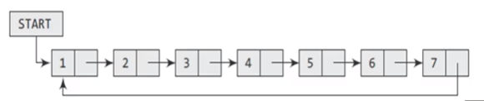
CIRCULAR LINKED LIST
In a circular linked list, the last node contains a pointer to the first node of the list.
While traversing a circular linked list, we can begin and traverse the list in forward direction until we reach the same node where we started.

Slide 4
Inserting a New Node in a Circular Linked List
Case 1: The new node is inserted at the beginning of the circular linked list.
Case 2: The new node is inserted at the end of the circular linked list.
Case 3: insertion somewhere in between the two nodes.

Slide 5
Insertion at the Beginning
Steps to insert a Node at beginning :
The first Node is the Head for any Linked List.
When a new Linked List is instantiated, it just has the Head, which is Null.
Else, the Head holds the pointer to the first Node of the List.
When we want to add any Node at the front,
we must make the head point to newly added node.
Next pointer of newly added Node, must point to previous Head, whether it be NULL(in case of new List) or the pointer to the first Node of the List.
The previous Node pointed by Head is now the second Node of Linked List, because the new Node is added at the front.

Slide 6
class Node
{
int info;
Node *next;
};
class circular_list
{
public:
Node *last;
circular_llist()
{last = NULL;}
};

Slide 7
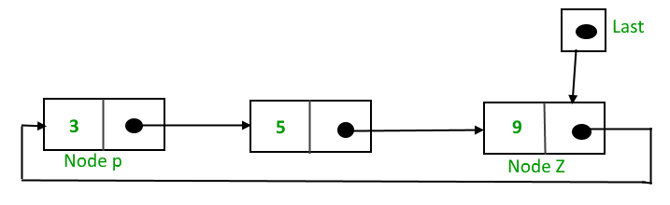
To implement a circular singly linked list
Take an external pointer named “last” that points to the last node of the list.
last -> next will point to the first node.
The pointer last points to node Z
last -> next points to node P.
The idea of pointer that points to the last node instead of the first node
In General, insertion of a node at the beginning or at the end, the whole list has to be traversed.
If we take a pointer to the last node, then in both cases there won’t be any need to traverse the whole list. (i.e. it takes constant time, irrespective of the length of the list)

Slide 8
Algorithm
void circular_llist::add_begin(int val)
{
node *temp = new Node();
temp->info=val;
if (last == NULL)
{
last=temp;
temp->next=last;
}
else
{
temp->next = last->next;
last->next = temp;
}

Slide 9
Algorithm Comparison Insert at Beginning
Circular
Single
void circular_llist::add_begin(int val)
{
node *temp = new Node();
temp->info=val;
if (last == NULL)
{
last=temp;
temp->next=last;
}
else
{
temp->next = last->next;
last->next = temp;
}
void insert_beg(int val)
{ node *temp=new node;
temp->info=val;
If(head==NULL)
{
head=temp;
temp->next=NULL
}
else{
temp->next=head;
head=temp; }
}

Slide 10
Insertion between the Nodes of Circular Linked List
Search for the node after which new node to be inserted,
(say node with value 20)
10
20
55
70
temp -> next = cur -> next;
cur -> next = temp;
40
Cur
Last
Temp ->New node
cur = last->next;
While(cur-info != requiredVal)
cur = cur -> next;
temp -> next = cur -> next;
cur -> next = temp;

Slide 11
Alternatively, we can also use two pointers ( prev & cur ) as follows
temp -> next = cur;
prev -> next = temp;
10
20
55
70
40
Prev
Cur
Last
prev = last;
cur = last->next;
while(prev-info != requiredVal)
pre=cur
cur = cur -> next;
temp -> next = cur;
prev -> next = temp;

Slide 12
Algorithm Comparison Insert at some position
Circular list Singly linear list
void insert_position(int pos, int val)
{
node *temp=new node;
node *pre;
node *cur;
temp->data=val;
If(head==NULL)
{
head=temp;
temp->next=NULL
}
cur=head;
for(int i=1;i<pos;i++)
{ pre=cur; cur=cur->next; }
temp->next=cur;
pre->next=temp
}
void insertNode( int item,int pos){
Node *New = new Node();
Node *Prev;
Node *Cur;
New->data = item;
if(last == NULL)
{
last = New;
last->next = last;
}
Prev = last;
Cur = last->next;
for (int i=1;i<pos;i++)
{ Prev = Cur;
Cur = Cur->next;
}
New->next = Cur;
Prev->next = New;
}

Slide 13
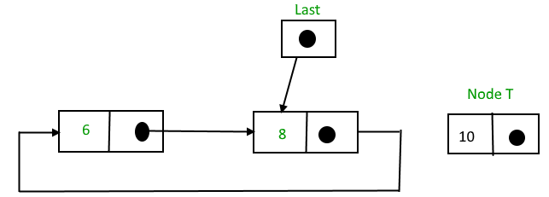
Insertion at the End of Circular Linked List
temp->next = last->next;
last->next = temp;
last = temp ;

Slide 14
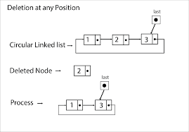
Deletion
Circular Linked List

Slide 15
Delete a node
in a single-node circular linked list
if(last=last->next)
{ cur = last;
last = NULL;
delete Cur;}
10
Last

Slide 16
Delete the head node from Circular List
{ cur = last->next;
last->next = cur ->next;
delete Cur;
}
10
20
40
55
70
last
Cur

Slide 17
Delete a middle node from a Circular Linked List
Search for the node which is to be deleted,
(say node with value 40)
pre -> next = cur -> next;
delete cur ;
10
20
40
55
70
Prev
Cur
last
cur = last->next;
pre = last
While(cur-info != requiredVal)
{pre= cur
cur = cur -> next;}
pre -> next = cur -> next;
delete cur;

Slide 18
Delete the end node from a Circular Linked List
cur = last->next
while(Cur->next!=last)
Cur=Cur->next;
Cur-> next = last->next
delete last;
last = cur;
10
20
40
55
70
cur
last

Slide 19
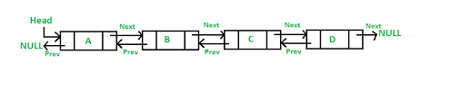
Doubly Linked List

Slide 20
Doubly Linked List
A doubly linked list or a two-way linked list is a more complex type of linked list which contains a pointer to the next as well as the previous node in the sequence.
Therefore, it consists of three parts—
data,
a pointer to the next node,
a pointer to the previous node

Slide 21
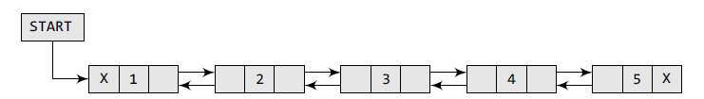
class Node
{
int info;
Node *next;
Node *prev;
};
PREV field of the first node is NULL
NEXT field of the last node is NULL.
The PREV field is used to store the address of the preceding node, which enables us to traverse the list in the backward direction.

Slide 22
Inserting a New Node in a Doubly Linked List
Case 1: The new node is inserted at the beginning.
Case 2: The new node is inserted at the end.
Case 3: The new node is inserted after a given node.
Case 4: The new node is inserted before a given node.

Slide 23
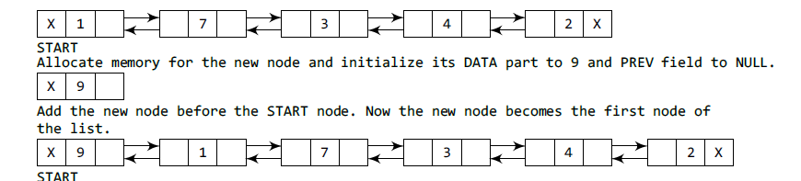
Inserting a Node at the Beginning
node *temp=new node;
temp->info=val; temp->prev=NULL;
If(start==NULL)
{ start=temp; temp->next=NULL;}
else{
temp->next=start;
start->prev=temp;
start=temp; }

Slide 24
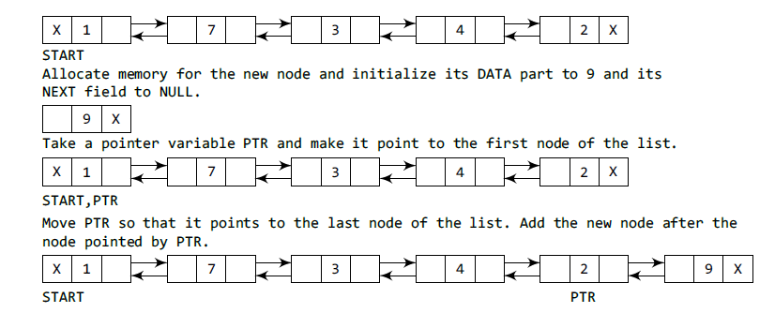
Inserting a Node at the End

Slide 25
Inserting a Node at the End
node *temp=new node;
temp->info=val; temp->next=NULL;
Node *ptr = start;
while(ptr->next!=NULL)
{ ptr=ptr->next; }
ptr->next=temp;
temp->prev=ptr

Slide 26
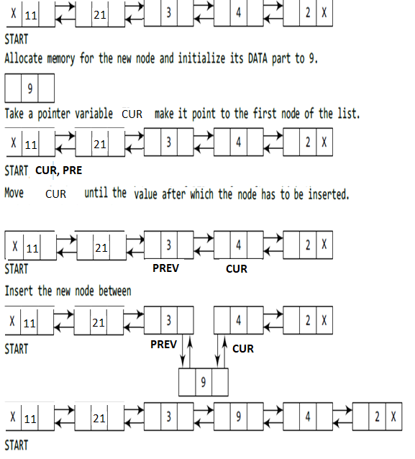
Inserting a Node After a Given Node
(say after third node)

Slide 27
Inserting a Node After a Given Node
node *temp=new node;
temp->data=data;
pre= start
cur=start->next
while (pre->data!= sp_val)
{ pre=cur; cur=cur->next; }
temp->next=cur; temp->prev=pre;
pre->next=temp;
cur->prev==temp;

Slide 28
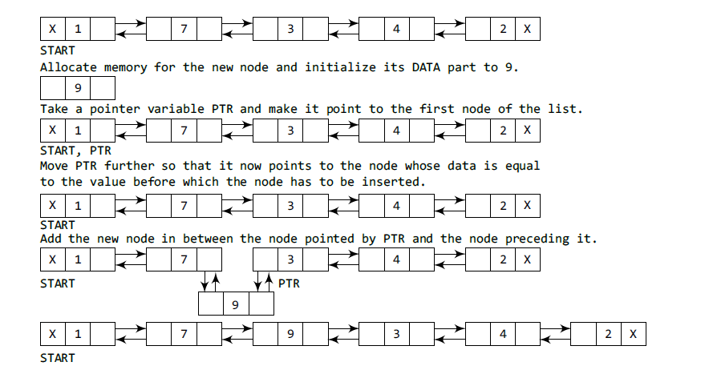
Inserting a Node Before a Given Node in a Doubly Linked List

Slide 29
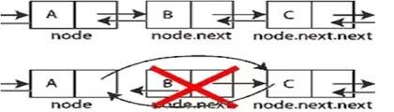
Deleting a Node from a Doubly Linked List

Slide 30
Deleting a Node from a Doubly Linked List
Case 1: The first node is deleted.
Case 2: The last node is deleted.
Case 3: The node after a given node is deleted.
Case 4: The node before a given node is deleted

Slide 31
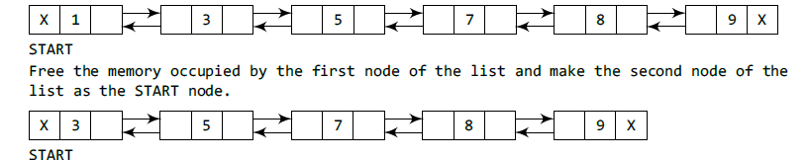
Deleting the First Node
if (start= =NULL)
cout<<“Underflow<<endl;
else
node *ptr;
ptr = head;
head=head→next;
head->prev=NULL
delete ptr;

Slide 32
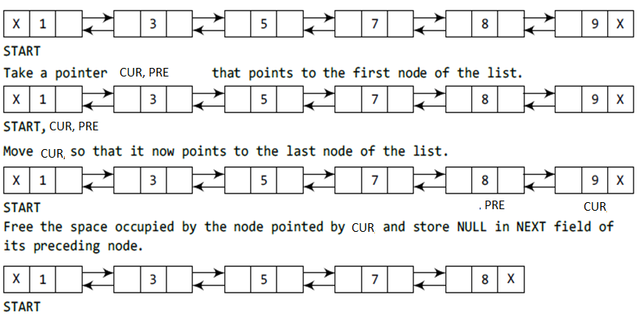
Deleting the Last Node
while(CUR->next!=NULL)
{ PRE =CUR; CUR=CUR->next;}
PRE->next = NULL;
delete CUR;

Slide 33
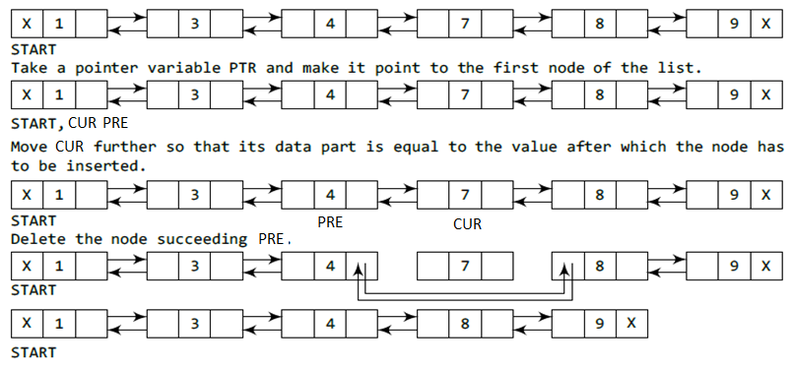
Deleting the Node After a Given Node
cur=start;
while (CUR->data!= sp_val)
{ PRE=CUR; CUR=CUR->next; }
PRE->next=CUR->next;
(CUR->next)->pre=PRE;
delete CUR;

Slide 34
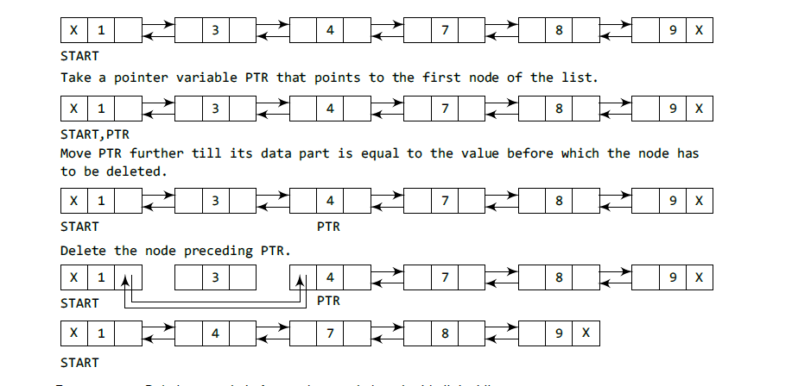
Deleting the Node Before a Given Node in a Doubly Linked List

Slide 35
Practice Activity
Implement Doubly Linked list by writing functions for all possible operations in doubly linked list.
Reverse a singly Linked List

Slide 36
Applications of Linked List
To implement many data structure for dynamic allocation like Stacks, Queues etc.
To implement the Adjacency list representation of Graph.
To implement Hash Tables – Ex. Open Chain Hashing (Each Bucket of the hash table can itself be a linked list.
To represent a polynomial by simply storing the coefficient and exponent of each term.
To implement “Undo” functionality in many software such as Photoshop or Word by storing Linked list of states.
Operating System maintains and control all the running applications by creating circular linked list
Representing Sparse Matrix

Slide 37
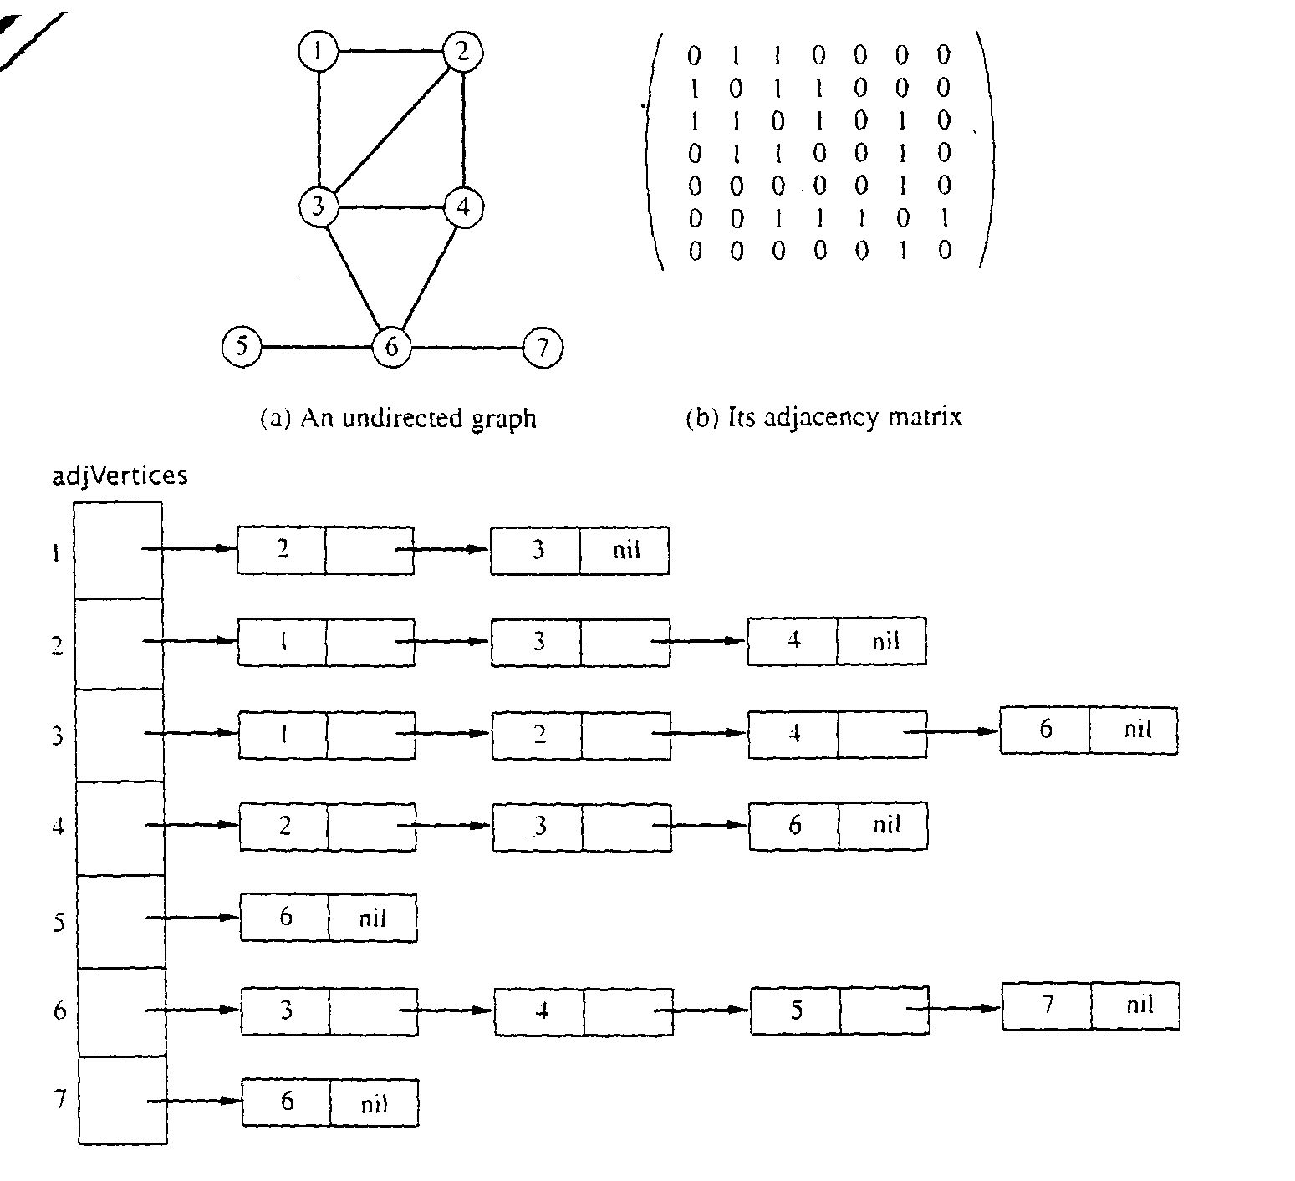
Adjacency Lists Representation
From
to

Slide 38
Complexity Analysis of Linked List Operations
List Type | Time Complexity
 | Worst
 | Search | Insertion | Deletion
Singly-Linked List
Doubly-Linked List
Circular Linked List

Slide 39
Complexity Analysis of Linked List Operations
Worst Time Complexity | Time Complexity
List Type | Search | Insertion |  |  | Deletion
 |  | Beg | Btw | End | Beg | Btw | End
Singly-Linked List | O(n) | O(1) | O(n) | O(n) | O(1) | O(n) | O(n)
Doubly-Linked List | O(n) | O(1) | O(n) | O(n) | O(1) | O(n) | O(n)
Circular Linked List | O(n) | O(1) | O(n) | O(1) | O(1) | O(n) | O(n)

Slide 40
Video Lecture of the topic can be found at
Basics of Linked List
https://youtu.be/5c6dNBc5qcM
How to Add Nodes to Linked List
https://youtu.be/7R49RIDJPNM
How to delete node from Linked List
https://youtu.be/3vcY0A0OfX4
How to Insert Node in Circular Linked List
https://youtu.be/4Xx6_NkimR4
How to Delete Node from a Circular Linked list
https://youtu.be/kvlPdTZxvD0
How to Add Node to Doubly Linked List
https://youtu.be/U83OzP6wgQ0
How to Delete Node From a Double Linked List
https://youtu.be/c4cDosriVMs
Analysis of Linked List Operations
https://youtu.be/NPsutdKrKNw

